Slide 1

RUNGTA COLLEGE OF DENTAL SCIENCES & RESEARCH
TITLE OF THE TOPIC : Diagnosis and Treatment Planning for
Complete Dentures- part one
DEPARTMENT OF PROSTHODONTICS AND CROWN & BRIDGE

Slide 2
Specific learning Objectives
At the end of this presentation the learner is expected to know ;
Core areas* | Domain ** | Category #
Introduction | Cognitive | Must Know
Definitions | Cognitive | Must Know
Definitions | Cognitive | Must Know
Treatment Planning | Cognitive | Must Know
Treatment Planning | Cognitive | Must Know
Take Home Message | Cognitive | Must Know
Reference | Affective | Desired to know

Slide 3
Table of Content
Introduction
Definitions
Diagnosis
Treatment Planning
Take Home Message
Reference

Slide 4
Introduction
Successful complete denture therapy begins with a thorough assessment of the patient’s physical and psychological condition and determining a treatment that will deliver a functional complete denture that will satisfy the expectations of the patient.
It is a difficult task to master the skills necessary to construct a complete denture; it is equally a challenging to acquire the skills necessary to treat the patient as a whole.
Winkler - Essentials of Complete Denture Prostodontics 2nd Edition

Slide 5
Definitions
Diagnosis –
Diagnosis consists of planned observations to determine and evaluate the existing conditions, which lead to decision making based on the conditions observed. – Boucher (13th edition)
The determination of the nature of a disease – GPT (9Th Edition)
Diagnosis is the examination of the physical state, evaluation of the mental or psychological makeup, and understanding the needs of each patient to ensure a predictable result. – Winkler (2nd Edition)

Slide 6
In short, DIAGNOSIS can be summarized as:
Recognizing the problem
Formulating the plan
Carrying out the necessary
Examination
Interpreting the result.

Slide 7
Treatment plan :-
Treatment planning means developing a course of action that encompasses the ramifications and sequelae of treatment to serve the patient’s needs – Winkler (2nd Edition)
2. The sequence of procedures planned for the treatment of a patient after diagnosis. - GPT (9th edition)

Slide 8
PRINCIPLES OF PERCEPTION
Diagnosis
Detection: noticing something
Discrimination: Distinguish that which we have noticed from something else.
Recognition
Identification
Judgement
ZARB and BOLENDER,PROSTHODONTIC TREATMENT FOR EDENTULOUS PATIENTS - 12TH EDITION

Slide 9

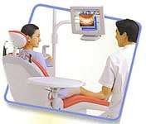
GENERAL INTRODUCTION TO THE PATIENT
First appointment → most important time
Fact finding
Development of mutual trust & understanding
Familiar with the overall condition of the patient
New patients + patients with previous experience → complete history taking & thorough examinations in which perceptive abilities of the dentist play an important role.
Winkler - Essentials of Complete Denture Prostodontics 2nd Edition
9

Slide 10
OBSERVATION OF THE PATIENT
Begins when the patient enters the dental clinic.
Aspects to be observed
Motor skills
Facial features
Attitude and Adaptive Response
Winkler - Essentials of Complete Denture Prostodontics 2nd Edition
10

Slide 11
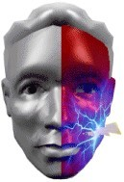
Motor Skills:
CVA, Bell’s Palsy, nerve blocks for trigeminal neuralgia - hemiplagia and dyskinesia.
Facial tremors/spasms indicate Parkinson’s disease, nervous habits or possibly drug induced tardive dyskinesia.
Dizziness may be a side effect of medication or a cerebrovascular accident.
Winkler - Essentials of Complete Denture Prostodontics 2nd Edition

Slide 12
Vertigo may also be due to orthostatic hypotension or be a signal of low blood pressure, overcorrected high blood pressure, or cerebral ischemia.
Ankle edema is often associated with congestive heart failure, poor circulation, or kidney disease
Psychotropic drug therapy may show
  Uncontrollable chewing movements
  Licking and smacking of lips
  Unco-ordinated tongue movements
  Twitching of the nose
  Puffing of cheek

Slide 13
DIAGNOSIS:
Check fluency and quality of patient’s speech
Best judged during casual conversation
If the speech problem is not due to the present dentures, it is not likely to be corrected or improved with new prostheses.

Slide 14
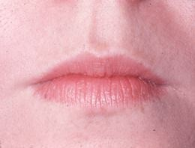
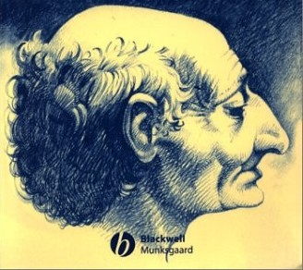
2. Facial features:
Dentist must note
Length and Form of face
Labial fullness
Apparent support of lips
Winkler - Essentials of Complete Denture Prostodontics 2nd Edition

Slide 15
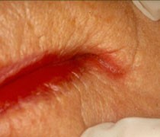
Lip Examination
¬
Cracking, fissuring at corner & ulceration: indicative of vitamin B-complex deficiency, candida infection, overclosure of existing denture or neoplasm.
Lip support
Lip thicknes
Lip length

Slide 16
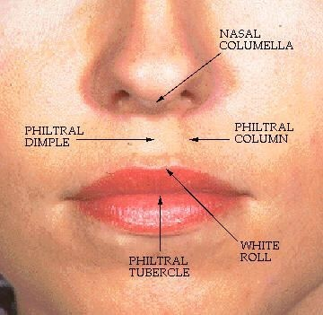
Observe for hollowness/puffiness in
Philtrum
Nasolabial fold
Labiomental groove

Slide 17
Texture of skin → determines the tone for anterior teeth setup
6. Rough textured skin deserves a more rugged tooth arrangement than smooth, light coloured skin.
Winkler - Essentials of Complete Denture Prostodontics 2nd Edition

Slide 18
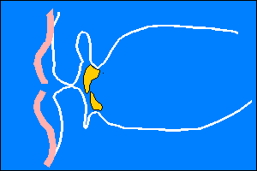
Size of oral cavity, activity of lips and width of vermilion border - directly related to degree of tooth display.
Profile view indicates position of maxilla to mandible - first indication of patient’s occlusal classification.

Slide 19
3. Attitude & Level of Expectation:
Factors producing adaptive response to complete dentures:
Acceptance of & confidence in dentist
Previous favourable experience & capacity to cope favourably with change
Favourable physical conditions Realistic expectation of the patient Good learning capacity
Desire to please the doctor
Winkler - Essentials of Complete Denture Prostodontics 2nd Edition

Slide 20
Factors that produce a maladaptive response to complete dentures
Lack of trust in the dentist
Poor dentist-patient communication Negative previous experience
Unrealistic expectations on the part of the patient Resistance to change
Inadequate tissue tolerance

Slide 21
THE HOUSE CLASSIFICATION
Proposed by Dr. Milus M. House in 1937
General classification of patient’s mental attitude
They can be classified as:
Philosophic
Exacting
Hysterical
Indifferent

Slide 22

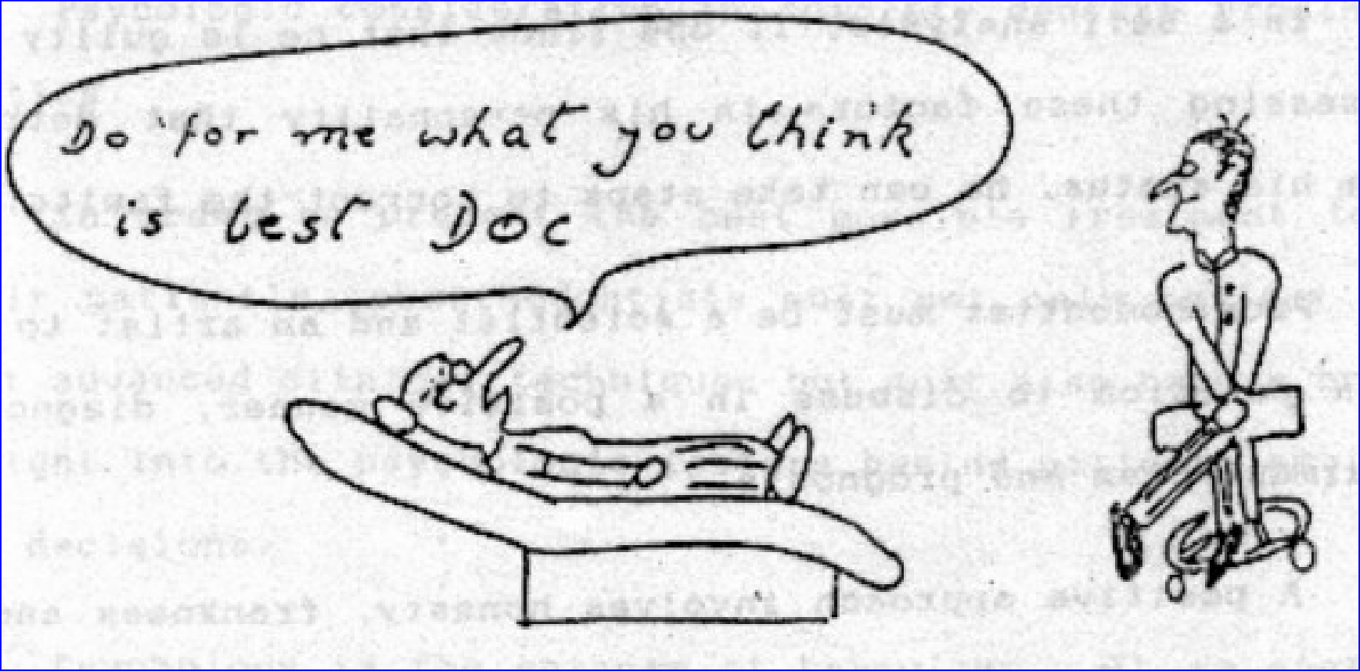
PHILOSOPHIC:
Willing to accept the dentist’s judgement without question.
Best mental attitude for denture acceptance.
Motivation is generalized.
Ideal attitude for successful treatment, provided the biomechanical factors are favourable.

Slide 23
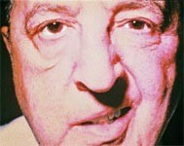
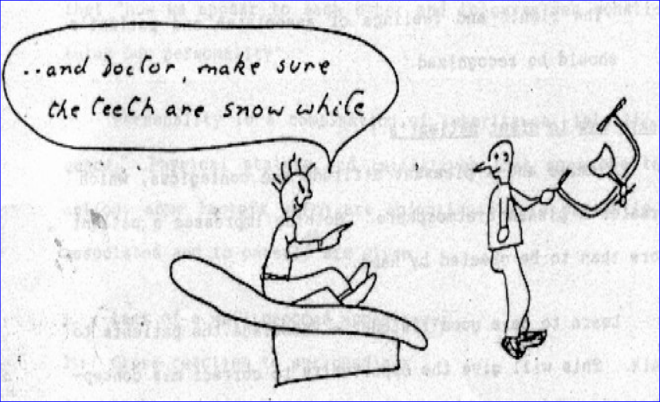
EXACTING:
All good attributes of philosophic patient.
Require extreme care, effort and patience on the part of the dentist.
Methodical, precise and accurate and at times make severe demands.
Like each step of the procedure to be explained.
If intelligent and understanding − they are the best
or else extra hours must be spent, prior to treatment, in patient education until an understanding is reached.

Slide 24

HYSTERICAL:
Emotionally unstable, excitable, apprehensive and hypertensive.
Prognosis is often unfavorable.
Additional professional help (psychiatric) is required prior to and during treatment.

Slide 25
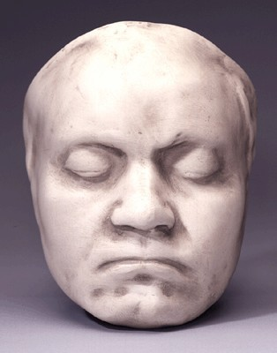
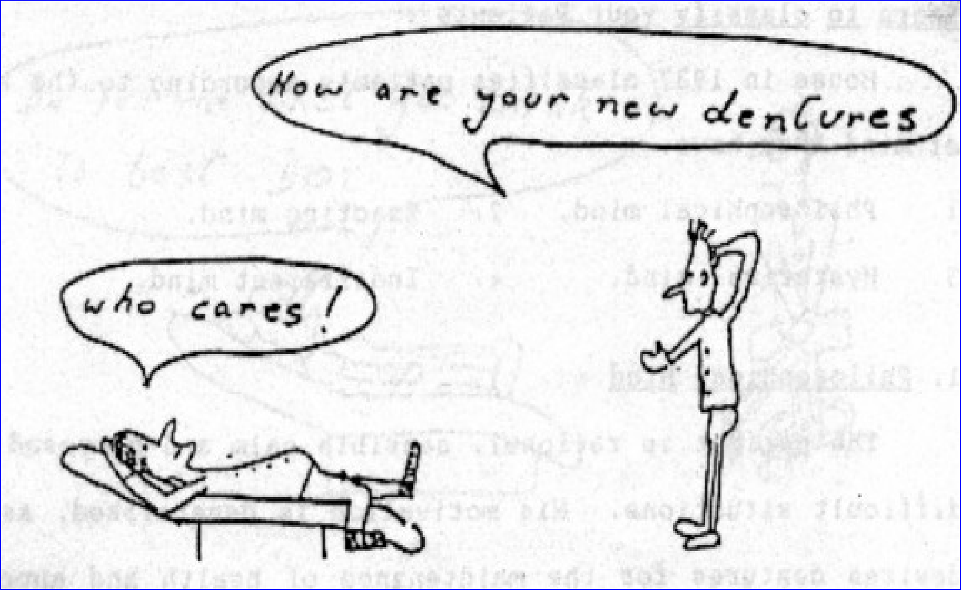
INDIFFERENT:
Questionable or unfavorable prognosis.
Little concern for their teeth or oral health.
Seek treatment because of the insistence of family.
Pay no attention to instructions, are uncooperative & give up easily if problems are encountered with their new teeth.
Require more time for instruction on value and use of their dentures.

Slide 26
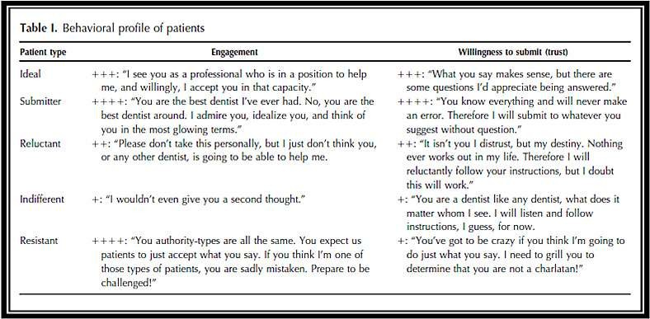
New Classification
SIMON GAMER,TUCH,GARCIA. MM House Mental Classification Revisited : Intersection Of Particular Patient Types & Particular Dentist’s Needs. J Prosthet Dent. 2003; 89:297-302.

Slide 27
C. HEALTH HISTORY
Patients today have a more complex health history than ever before.
More likely to involve the dentist in medicolegal challenge.
Therefore a complete health history is an extremely important part of the patient’s overall diagnosis and treatment planning.
Winkler - Essentials of Complete Denture Prostodontics 2nd Edition

Slide 28
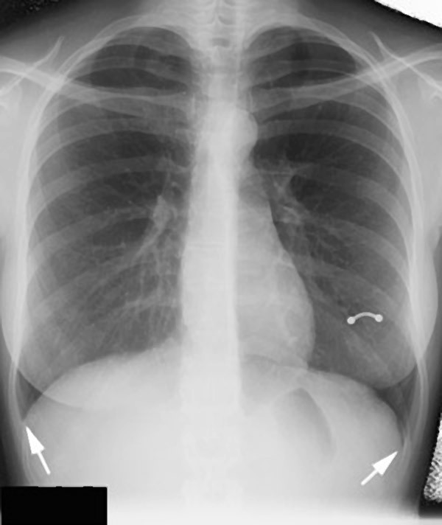
(i) Systemic Status of the Patient:
DEBILITATING DISEASES
They must be kept under medical control Eg. Diabetes, Blood Dyscrasias and TB
Require
Extra instruction in oral hygiene, eating habits & tissue rest
Physician consultation
Frequent recall appointments to check the status of underlying bone and thus occlusion

Slide 29
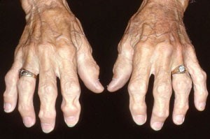
DISEASES OF THE JOINTS
Primary osteoarthritis:
¬
¬
¬
Familial disease
More common in females
“Heberdens nodes” involving terminal joints of fingers ◊ difficult for patient to insert & clean dentures

Slide 30
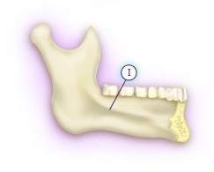
Osteoarthritis of TMJ:
Painful mandibular movements ◊ difficulty in construction of dentures
Special impression trays ◊ accommodate reduced mouth opening
Difficulty in recording jaw relations
Occlusal corrections have to be made often

Slide 31
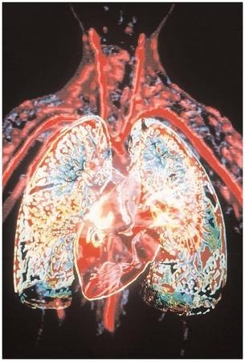
CARDIOVASCULAR DISEASES
Consultation with patients cardiologist is indicated
Surgical procedure of any nature maybe contraindicated
Short appointments with pre- medication
¬

Slide 32
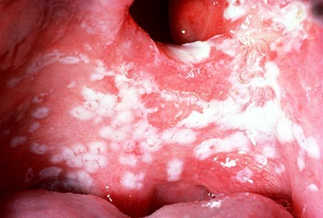

DISEASES OF SKIN
¬
May have oral manifestations Eg. Pemphigus & lichen planus
Oral mucosa is very painful
Medical treatment may or may not give comfort
Constant use of dentures is contraindicated ◊ their use is primarily for mental comfort
¬
¬
¬

Slide 33
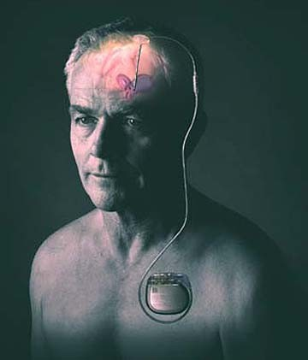
NEUROLOGICAL DISORDERS:
Eg. Bells palsy Parkinson’s disease
Added Problems:
¬
¬
Denture retention
Maxillo-mandibular relation records
Supporting musculature
¬

Slide 34
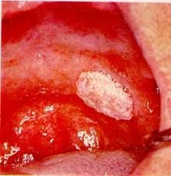

ORAL MALIGNANCIES
Most often detected by the dentist
Treatment of choice = eradication of lesion by surgery or radiotherapy.
Prosthodontic treatment therein is best handled by a maxillofacial prosthodontist.
¬
¬
¬
Radiation therapist must be consulted ◊ if tissues lack tonus & have a bronze colour denture construction should be delayed.
Observe for signs of radiation necrosis Dentures should be used on a limited basis

Slide 35
MENOPAUSE:
¬
¬
Bone changes: generalized osteoporosis
Mental disturbances: mild irritability to complete nervous breakdown
Oral symptoms: hot flushes, burning tongue, burning palate and vague area pains.
Tranquilizers and psychotherapy may help.
Patient should be made aware of these conditions and their possible effect during the period of denture adjustment.
¬
¬
¬

Slide 36
TAKE HOME MESSEGE
All the facts must be known before they can be correlated in such a way that decision can be made. Only then can treatment plans be developed to best serve the needs of each individual patient.
For the patient to be happier the dentist should not only require the skills of complete denture construction but also the skills to treat a patient’s aspirations & expectations.

Slide 37
Reference
Boucher’s Prosthodontic Treatment For Edentulous Patients, 12th Edition
Winkler’s Essentials Of Complete Denture Prosthdontics, 2nd Edition
Zarb & Bolender’s Prosthodontic Treatment For Edentulous Patients, 13th Edition
Rahn & Heartwell’s Textbook Of Complete Denture, 5th Edition. 45-46

Slide 38


